Slide 1

You are very hungry, and go to restaurant and choose to eat a meal there.
What will you order???

Slide 2
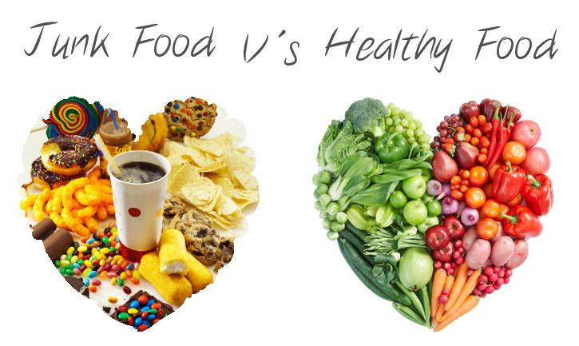
Did you order….
or

Slide 3
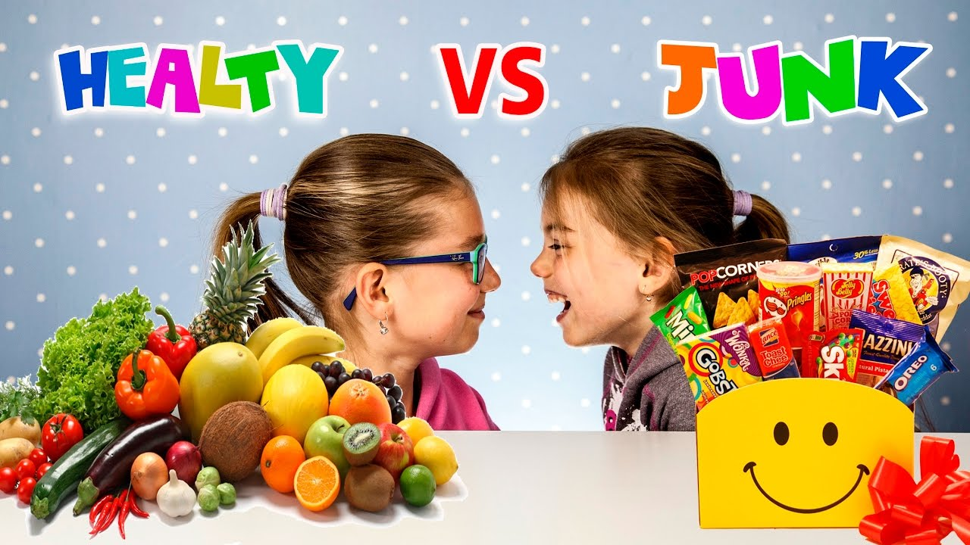

Slide 4
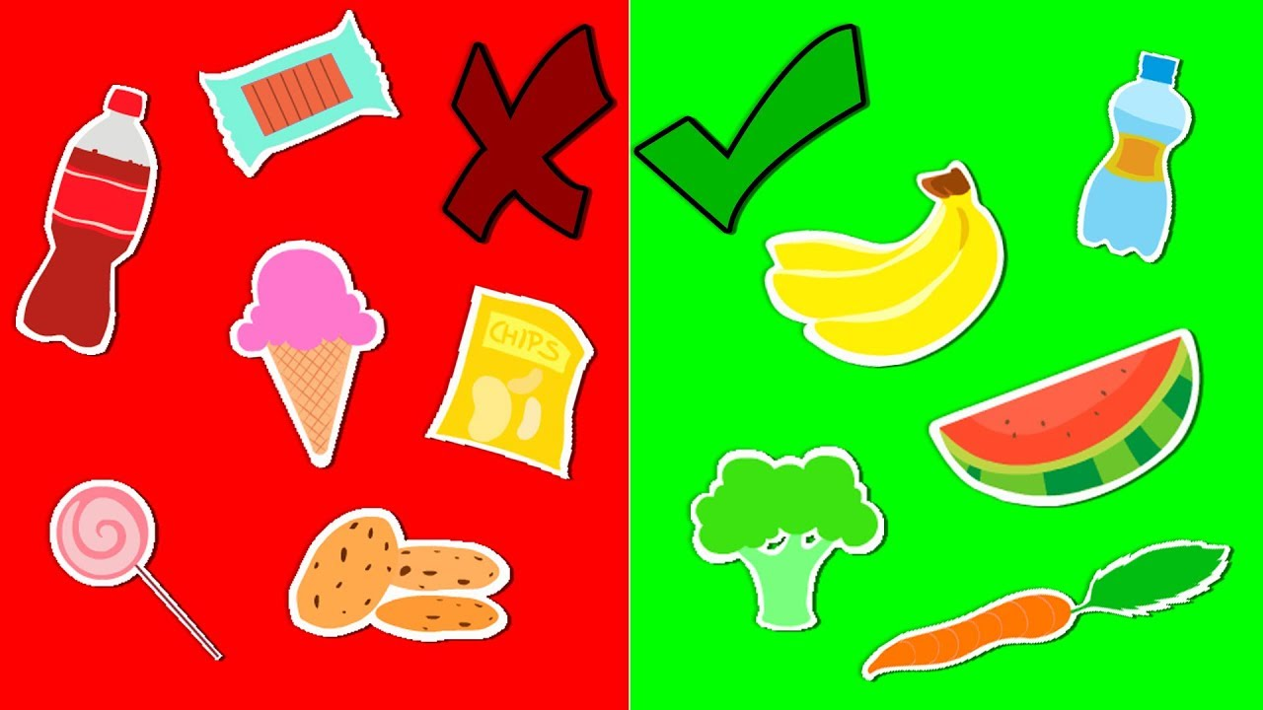
What is a junk food?
Junk foods have little or no health benefits.
Ingredients used are unhealthy.
Junk food contains high level of sugar, salt and fats.

Slide 5
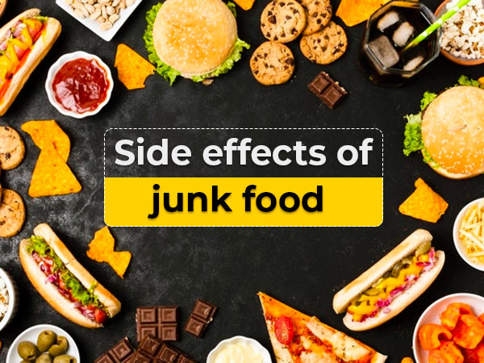
Why should we avoid junk food?
Lack of energy – Junk foods do not provide nutritional value.
Poor concentration – It makes you feel drowsy.
Obesity - weight gain due to excessive amount of body fat

Slide 6
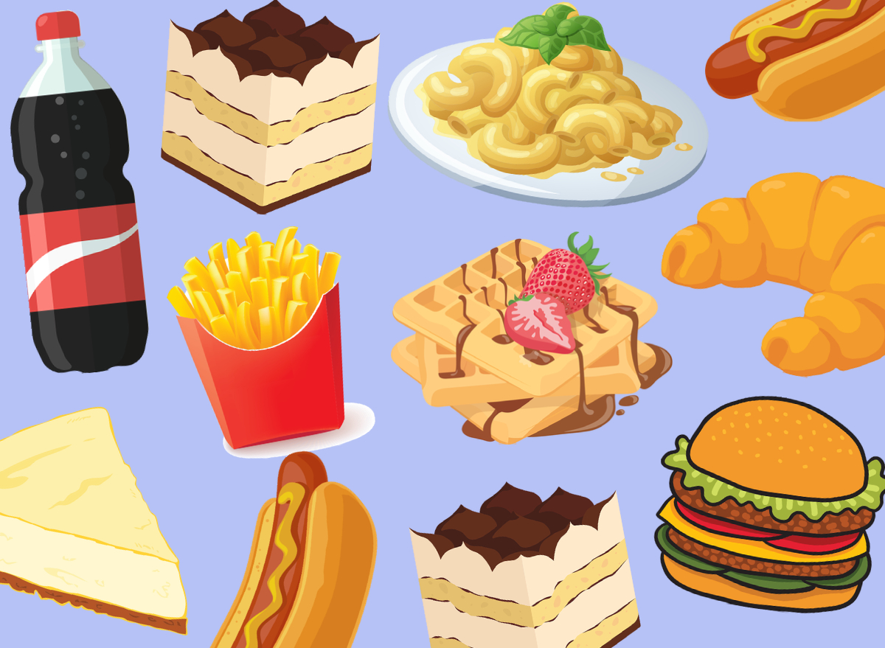
Examples of junk food
Hamburger
Carbonated drink (coke, sprite etc.)
French fries
Ice cream
Muffins
Cakes
Pasta
Noodles
You can eat junk occasionally

Slide 7
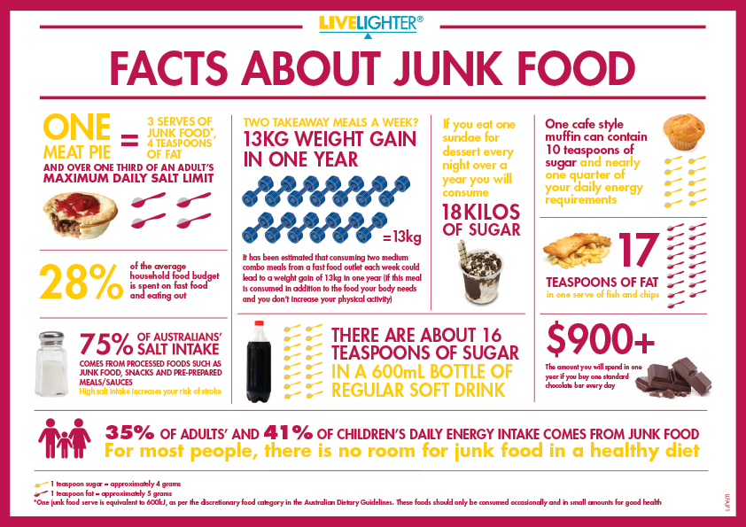

Slide 8
What is a healthy food?
Nutritional value
Gives energy
Maintains and improves your health
Contains proteins, carbohydrates, vitamins and fats

Slide 9
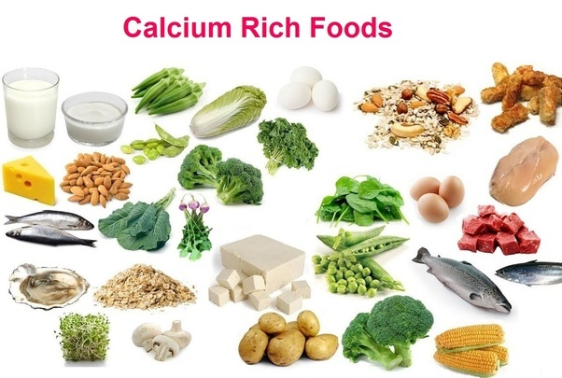

Slide 10
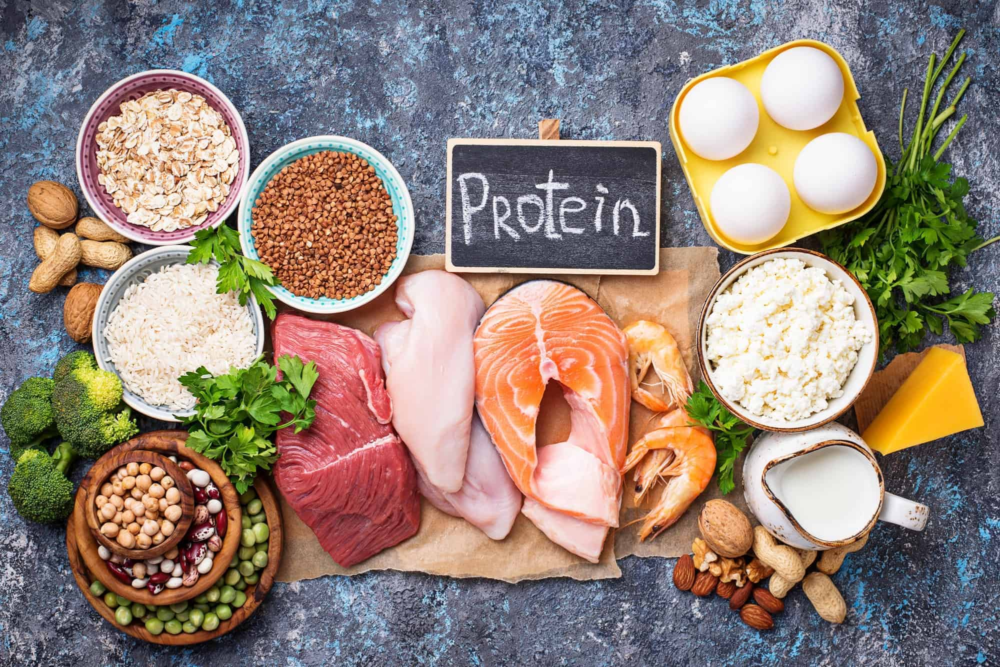

Slide 11
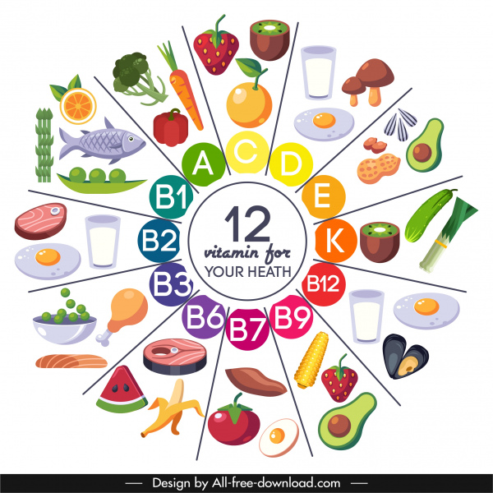

Slide 12


Slide 13
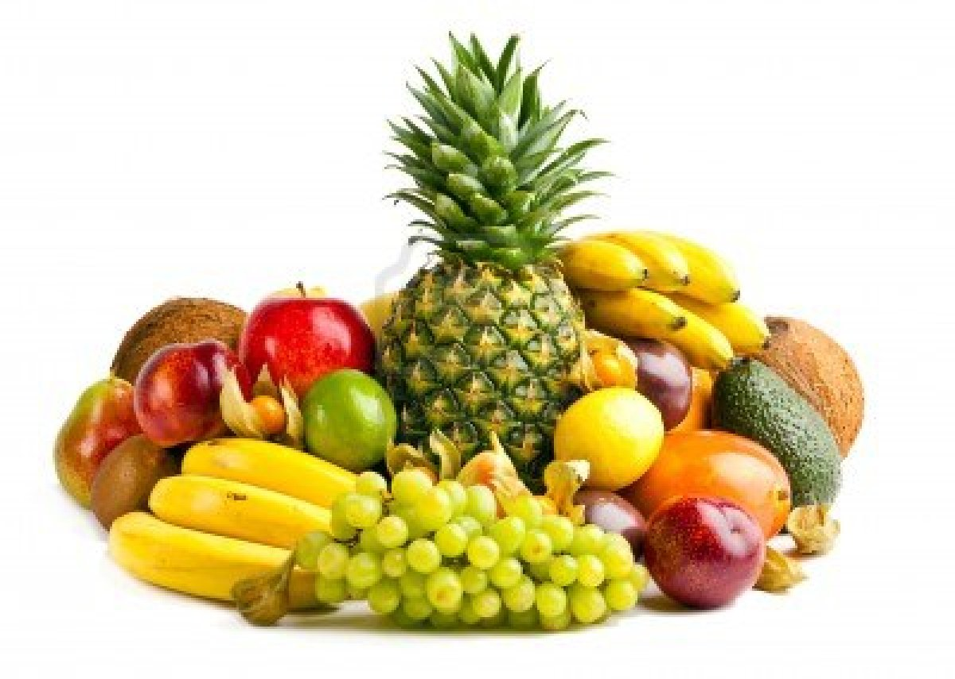
To stay healthy add more fruits in your diet

Slide 14
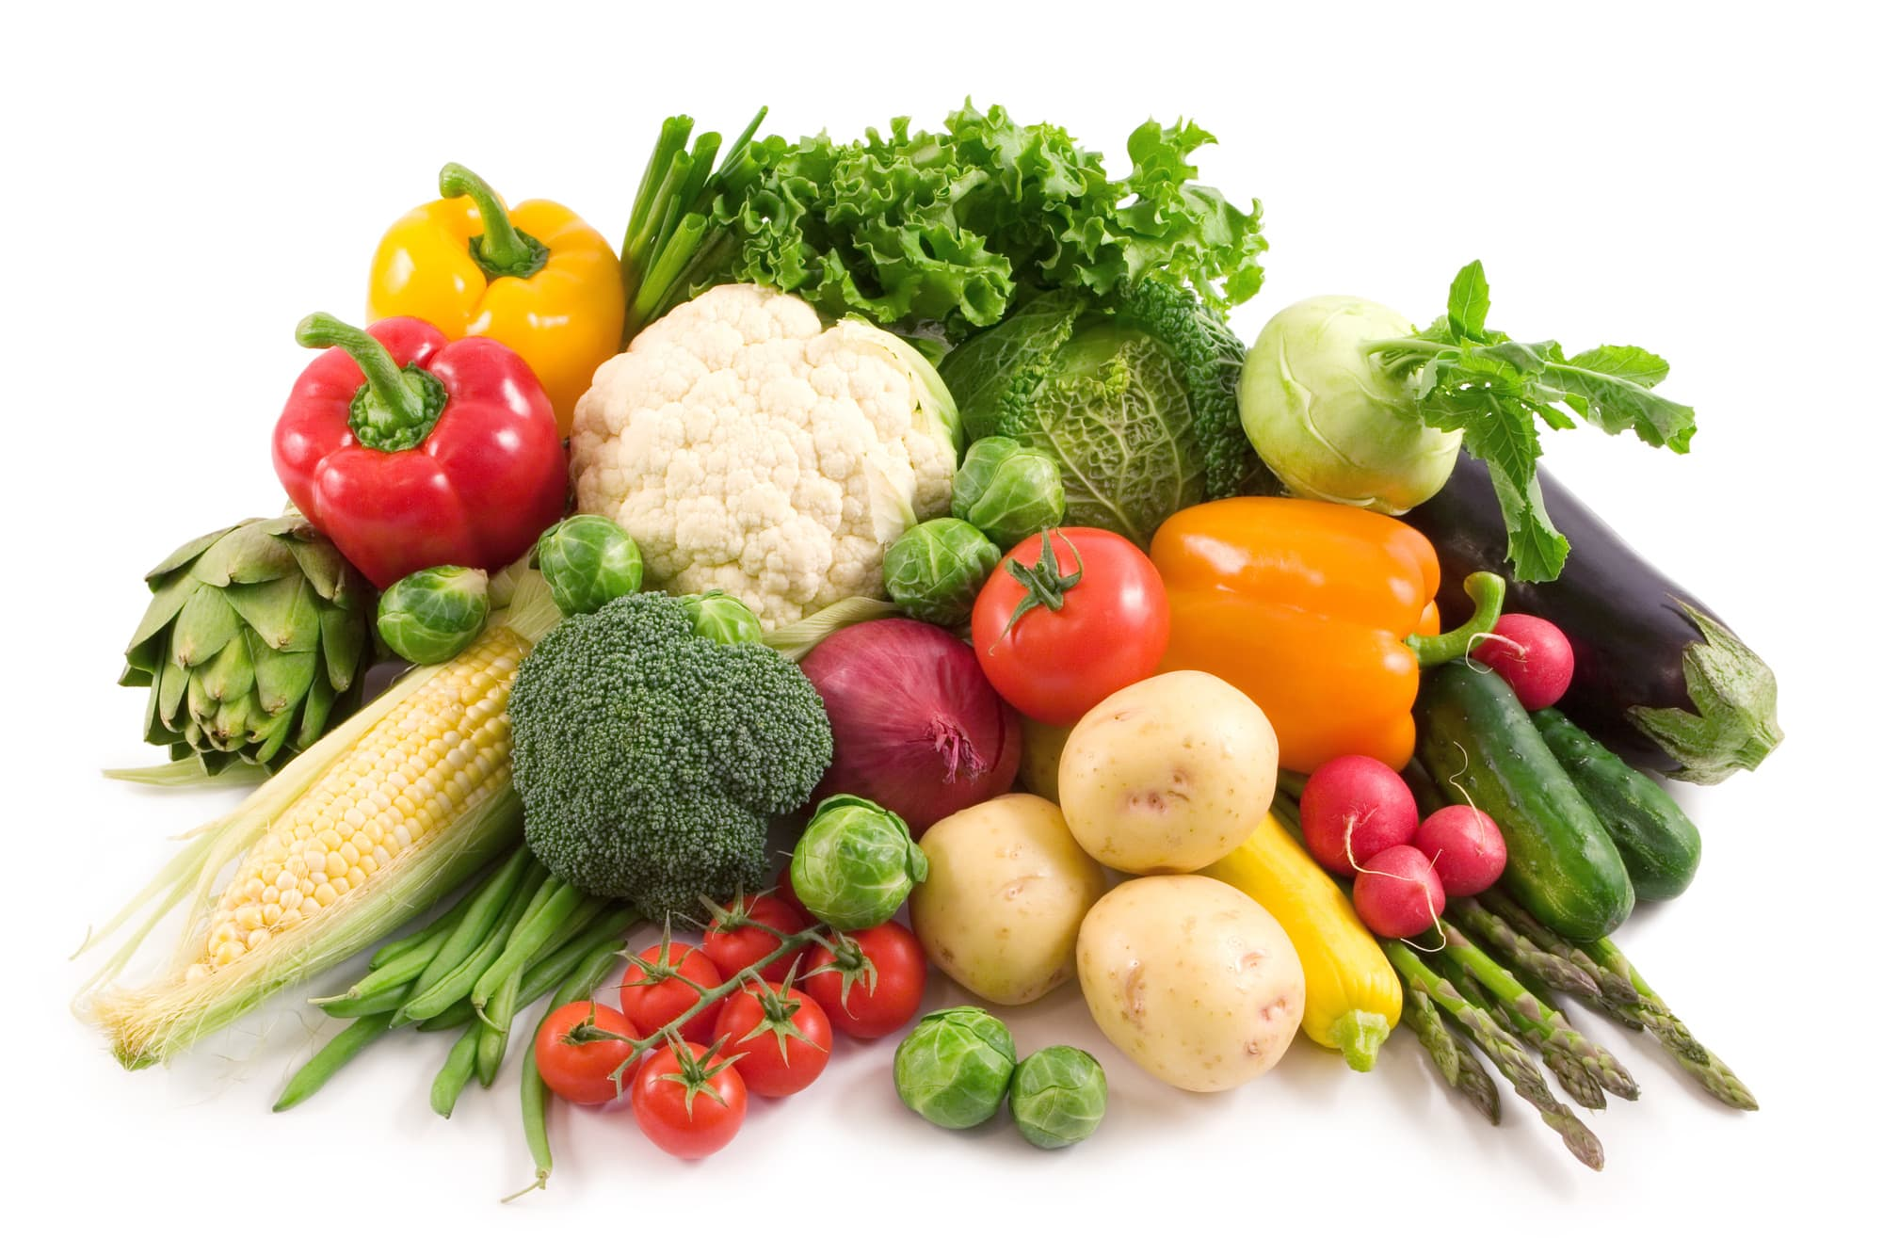
To stay healthy add more vegetables in your diet

Slide 15
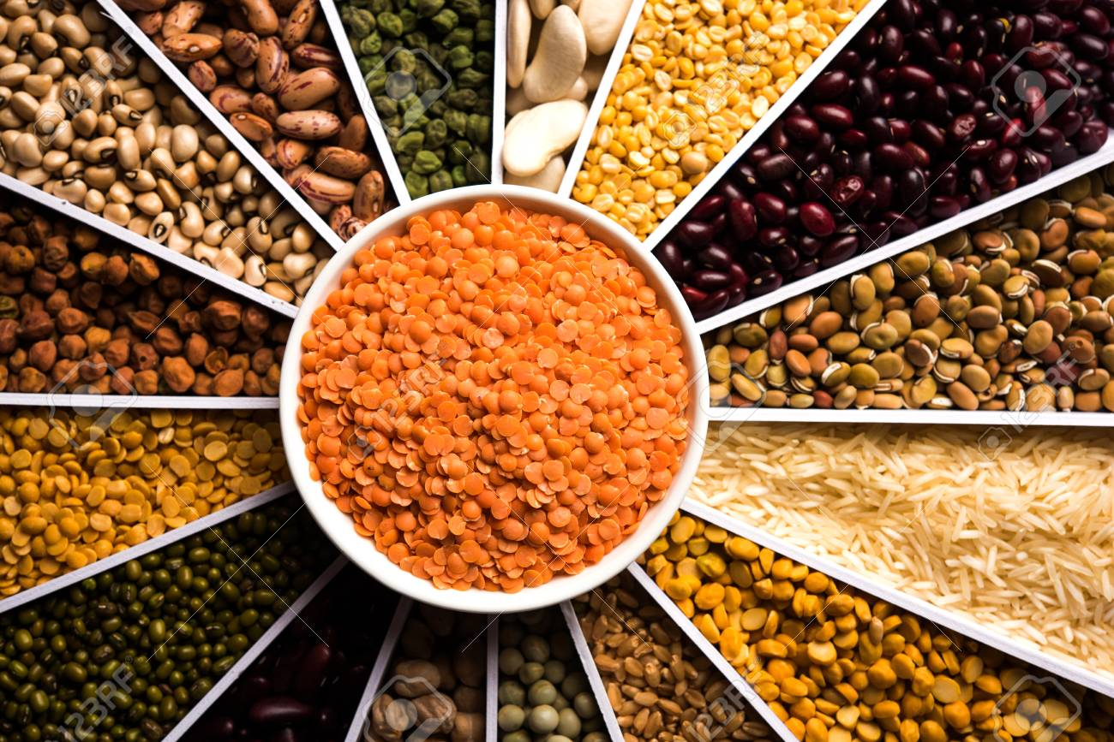
To stay healthy add more grains in your diet

Slide 16
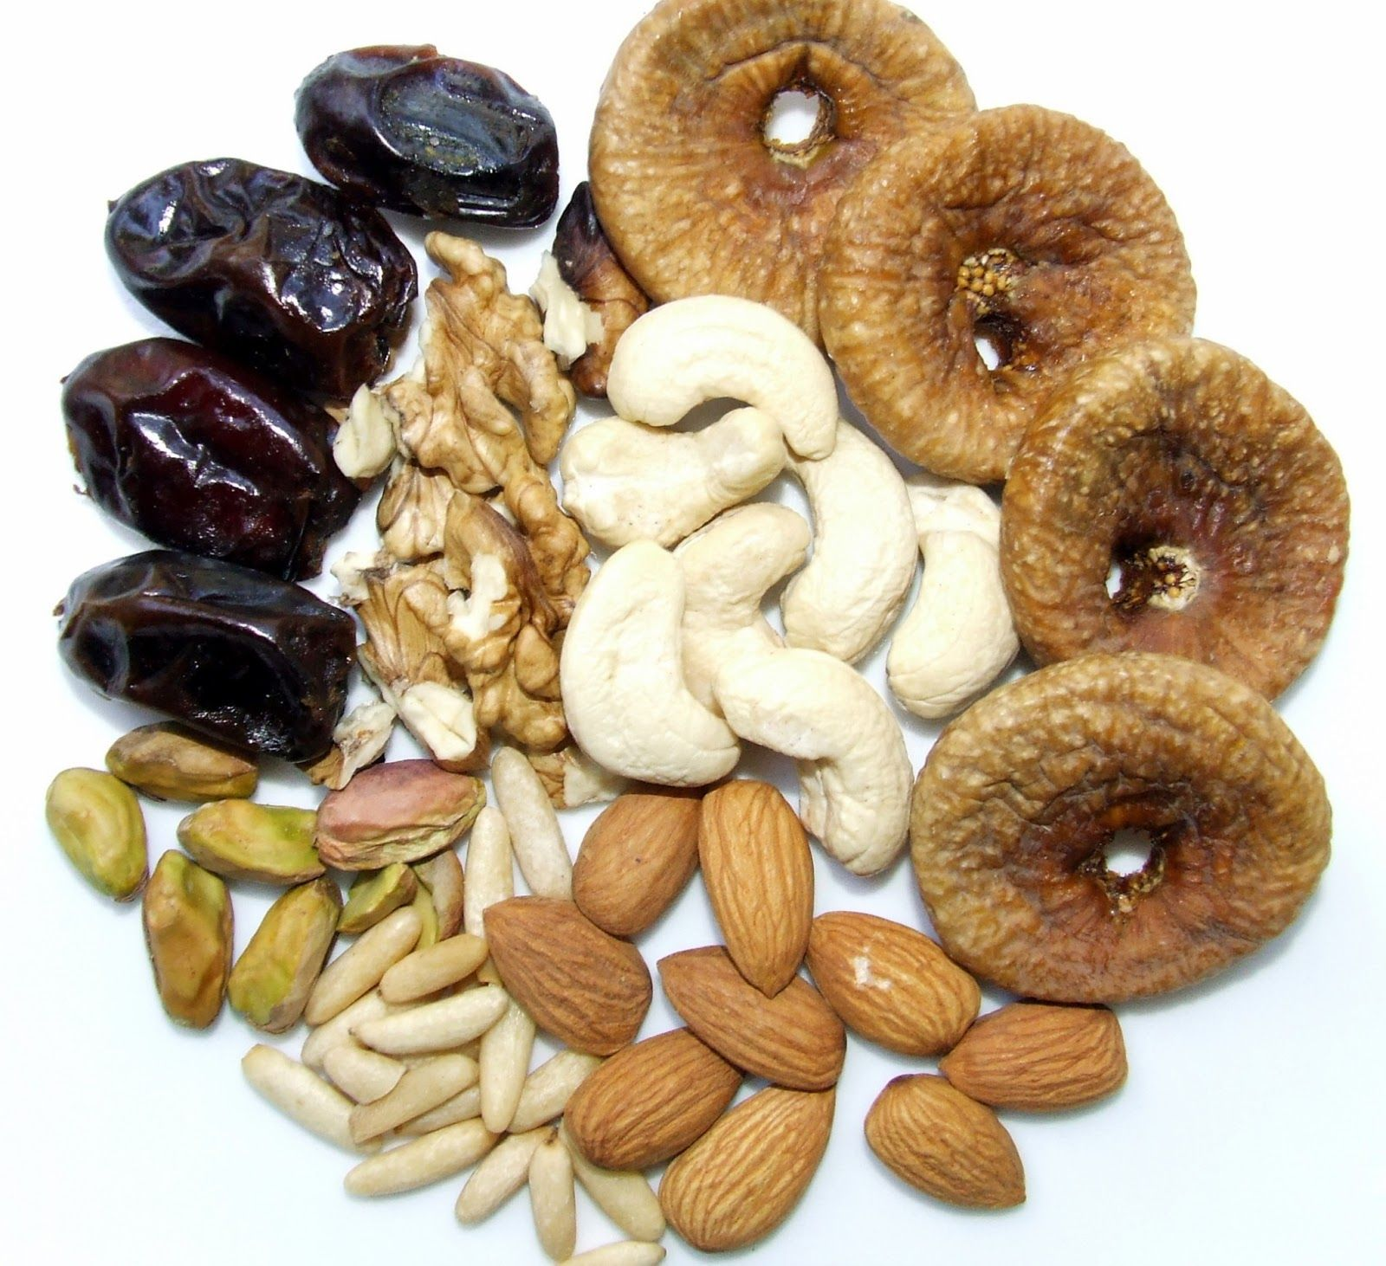
To stay healthy add more nuts and dry fruits in your diet

Slide 17
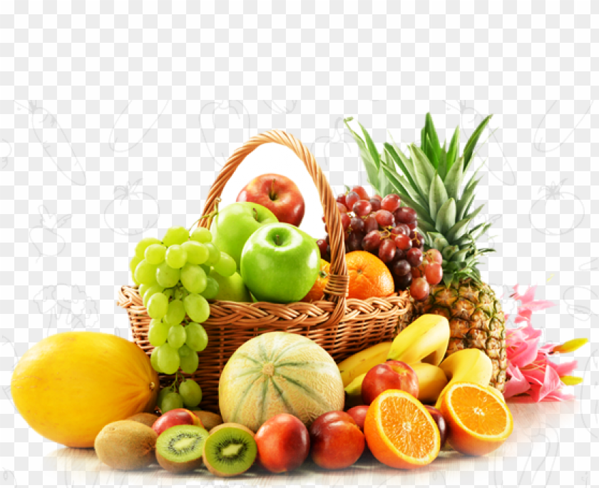
Name the fruits from the picture given below !!!

Slide 18
Guess the food items!

Slide 19
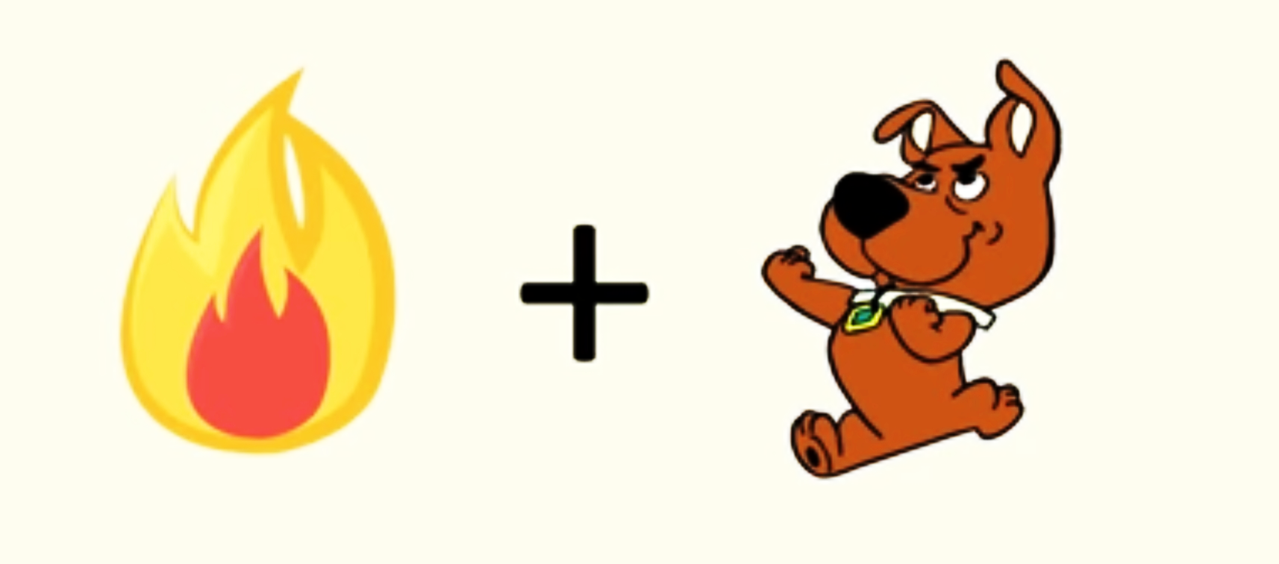
Hotdog

Slide 20
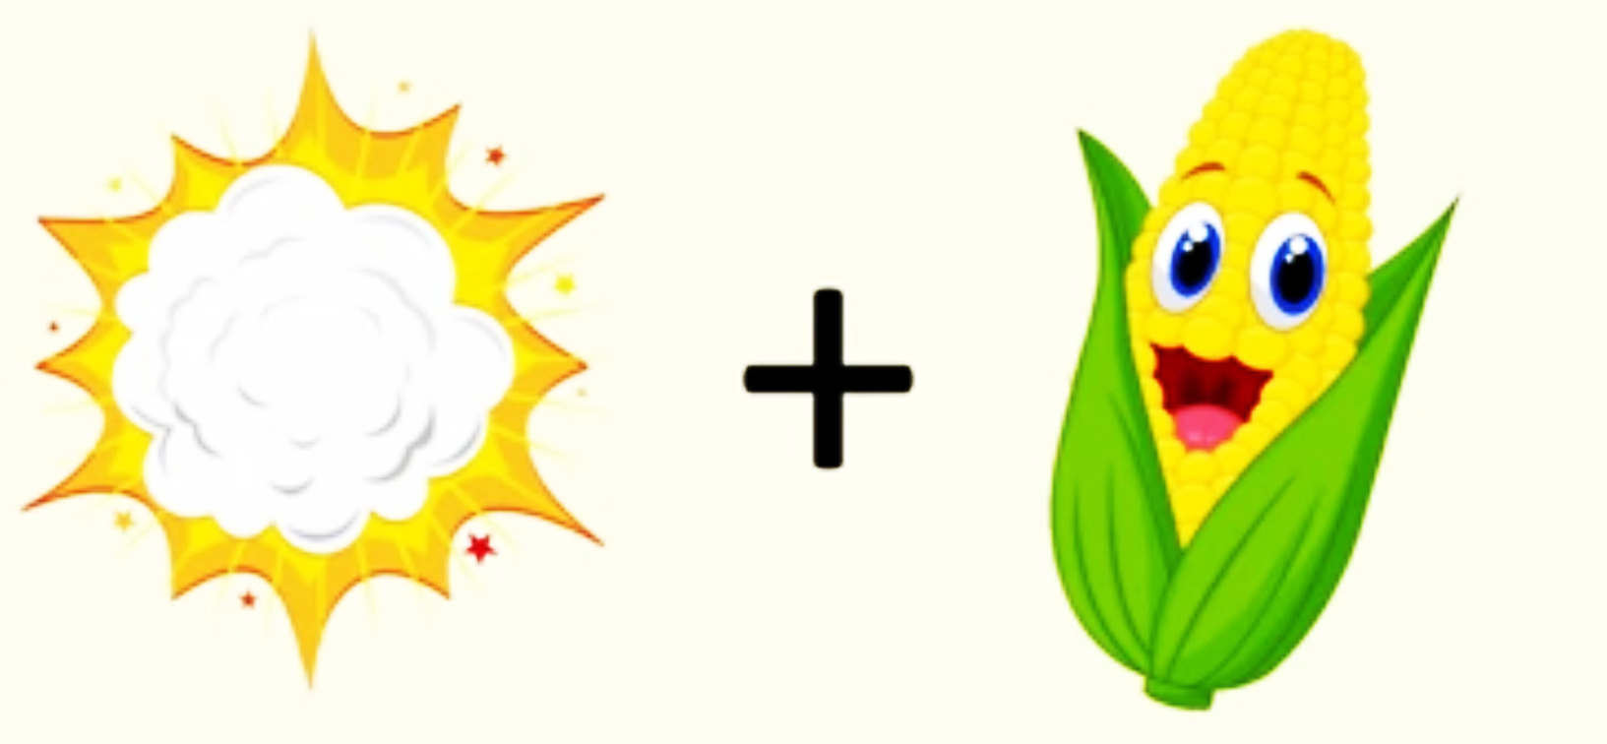
Popcorn

Slide 21
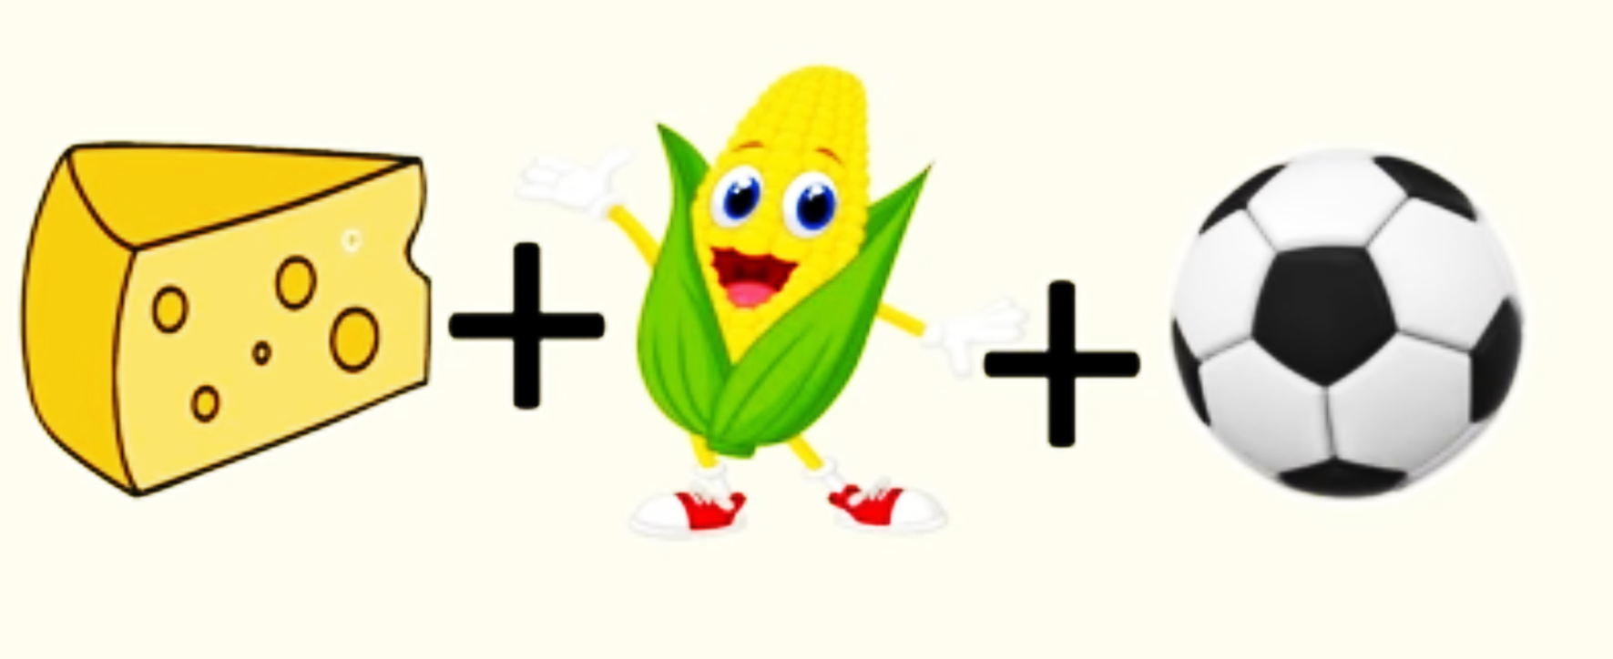
Cheese corn balls

Slide 22
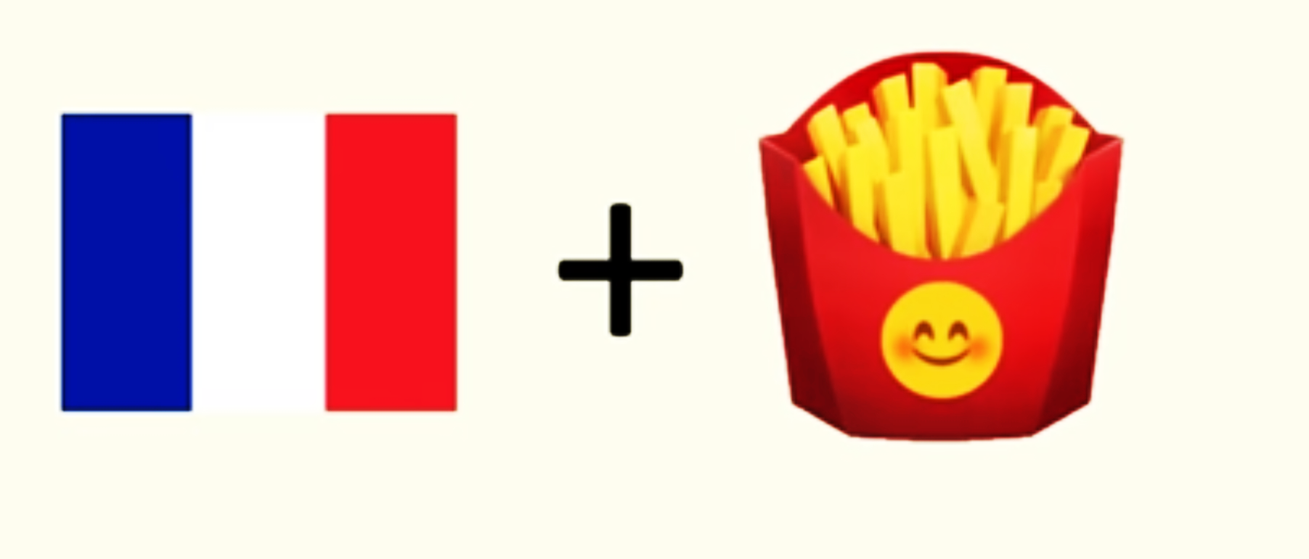
French fries

Slide 23
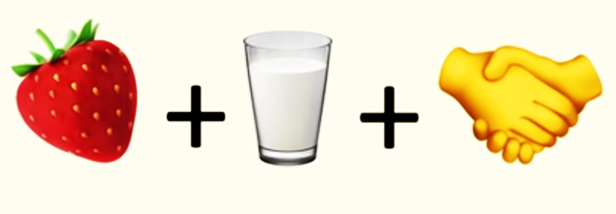
Strawberry milkshake

Slide 24
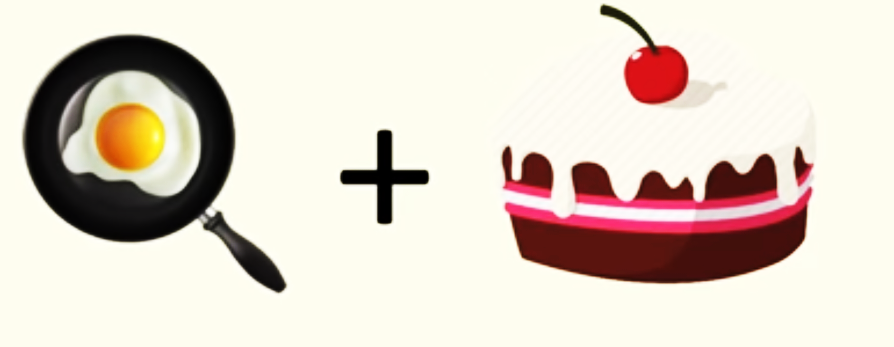
Pancake

Slide 25
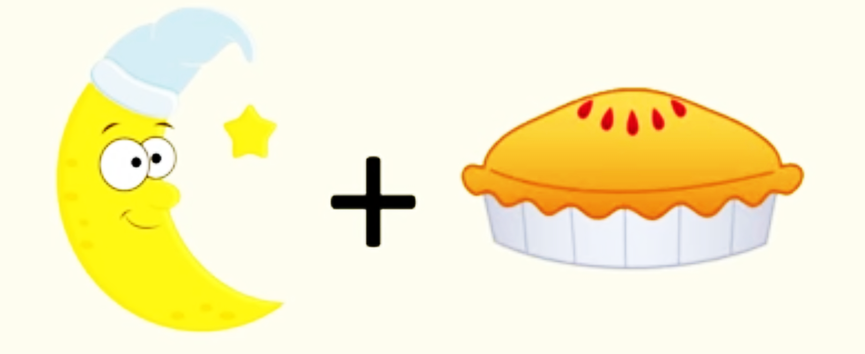
Moon pie

Slide 26
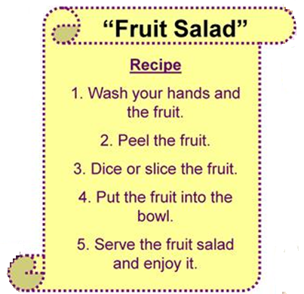
The greatest wealth is health
Activity
Make a fruit salad by yourself
Take a picture and send it.

